Slide 1
Introduction to Transaction Rules
8 September 2011
Notes:
Introduction to transaction rules - <number>
Guidewire training materials contain Guidewire proprietary information that is subject to confidentiality and non-disclosure agreements. You agree to use the information in this manual solely for the purpose of training to implement Guidewire software solutions. You also agree not to disclose the information in this manual to third parties or copy this manual without prior written consent from Guidewire. Guidewire training may be given only by Guidewire employees or certified Guidewire partners under the appropriate agreement with Guidewire.

Slide 2
Lesson objectives
By the end of this lesson, you should be able to:
  Describe the different sets of transaction rules
  Describe the transaction data model
  Work with transactions in Gosu
  Use the Financial Calculations library
  This lesson uses the notes section for additional explanation and information.
  To view the notes in PowerPoint, choose View→Normal or View→Notes Page.
  If you choose to print the notes for the lesson, be sure to select “Print hidden slides.”
Notes:
Introduction to transaction rules - <number>

Slide 3
Lesson outline
Transaction basics
Transaction data model
Transactions and Gosu
The financial calculations library
Notes:
Introduction to transaction rules - <number>

Slide 4


Review: Objects that implement financials
Exposure
Reserve
Line
Check
Payee
+$3000
-$3000
Reserve transaction
Payment transaction
Exposure tracks payment from coverage to claimant
Reserve line is money set aside for exposure payments
  Reserve transactions typically add money to it
  Payment transactions move money to checks
Checks transfer money from carrier to payee
Notes:
Introduction to transaction rules - <number>
An exposure is a set of data used to track a potential payment from one coverage to one claimant.
A reserve line is an amount of money set aside for expected payments related to a given exposure. Every exposure ultimately has one or more reserve lines. transactions modify the amount of money in a reserve line.
A reserve transaction modifies the amount of money set aside for the reserve line.
A payment transaction moves money from a reserve line to a payment to a claimant or other party.
A check is a single transfer of money from one or more reserve lines to one or more individuals or organizations.
A payee is a person to whom a check is made payable. Payees include both claimants and people who provided services for the claim (such as inspectors).

Slide 5
Review: transactions
reserve
transaction
+$2000
  -$1850
payment
transaction
"Non-recovery"
reserve line
recovery
reserve
transaction
+$3500
  -$3500
recovery
transaction
"Recovery"
reserve line
Transactions modify amount of money in reserve line
  Four types of transactions
  Remainder of the course focuses on reserve and payment transactions
Notes:
Introduction to transaction rules - <number>
A reserve transaction modifies the amount of money set aside for the reserve line. In most cases, a reserve transaction can be thought of as adding money to a reserve line. (However, there are circumstances where the amount of money set aside may have been deemed too high, and a reserve will be used to subtract money from a reserve line without actually paying that money to a claimant or other party.)
A payment transaction moves money from a reserve line to a payment to a claimant or other party. In most cases, a payment transaction can be thought of as subtracting money from a reserve line. (However, there are circumstances where a payment transaction credits money to a reserve line, possibly because an error occurred and the payee returned the money to the carrier.)
A recovery reserve transaction denotes money which the carrier expects to get from subrogation or salvage.
A recovery transaction denotes money which has been collected from subrogation or salvage.
Recall the following definitions:
Recovery is a general term that refers to all forms of recouping some of the payments made on a claim. There are two primary forms of recovery: subrogation and salvage.
Subrogation is the act of the carrier getting financial reimbursement from a 3rd party when someone insured by the carrier suffers a loss and it is not the insured's fault. For example, if Jim Means is insured by Acme Insurance and his car is hit by Florence Rigby, then Acme Insurance can attempt to collect money from Florence Rigby's insurance company to cover the money which Acme must pay to Jim Means for his loss. Subrogation is relevant only when there is a 3rd party who is responsible for the loss.
(continued)

Slide 6

(Notes only slide)
Notes:
Introduction to transaction rules - <number>
Salvage is the act of the carrier paying the full value of damaged property, taking possession of it, and then attempting to recoup some of the cost by reselling the property (or portions of it). For example, if Jim Means has an insured car which is damaged in a collision to the point where it can no longer be driven, Acme Insurance could pay the full value of the car to Jim Means, take possession of it, and then sell any salvageable parts to a scrap yard.
The example shown above is for a collision exposure in which the vehicle is a total loss. The carrier plans to pay the insured for the full value of the vehicle, which is $3500. The carrier then expects to be able to sell the vehicle to a salvage yard and recoup $3500.
A single reserve line can include both recovery and non-recovery transactions.

Slide 7
Transaction rules
(unique to setup)
(used during and outside setup)
Pre-setup
Pre-update
TransApproval
Post-setup
Validation
Appr. Routing
Six rule set categories which trigger off transaction event
  Which rules get executed and order of execution varies based on the type of transaction and type of activity (creation, modification, approval)
Notes:
Introduction to transaction rules - <number>
The rules executed for each new transaction:
Transaction Pre-setup
Transaction Approval rules
Approval rules (in Approval Routing rule set category)
Transaction Post-setup
Claim Pre-update
Transaction Pre-update
Claim Validation rules
Transaction Validation rules
Event Fired

Slide 8
Pre-/Post- rules
(unique to setup)
(used during and outside setup)
Pre-setup
Pre-update
TransApproval
Post-setup
Validation
Appr. Routing
Execute work unrelated to validation or approval
  Pre-/post-setup - executed only when transaction is created
  Pre-update - executed when transaction is created or modified
Covered in this lesson
Notes:
Introduction to transaction rules - <number>
The decision about where to write a given transaction rule should be determined by when the rule should be run.
If the rule should only be run when a transaction is created (and not every time the transaction is modified), then it should be in a pre-setup or post-setup rule.
If the rule should be run when a transaction is created and every time the transaction is modified, then it should be in a pre-update rule.

Slide 9
Approval rules
(unique to setup)
(used during and outside setup)
Pre-setup
Pre-update
TransApproval
Post-setup
Validation
Appr. Routing
Transaction approval - determine if transaction requires approval
Approval routing - if approval needed (based on approval rules or authority limits), route approval activity
Covered in the "Transaction Approval rules" lesson
Notes:
Introduction to transaction rules - <number>
Transaction Approval rules are run when a transaction is created and when it is edited or approved. (A transaction might require multiple approvals. Therefore, approval rules are run even when a transaction is approved.)
Approval Routing rules are run whenever a transaction is designated as requiring approval.

Slide 10
Validation rules
(unique to setup)
(used during and outside setup)
Pre-setup
Pre-update
TransApproval
Post-setup
Validation
Appr. Routing
Determine if transaction is valid and committable
  Can raise warnings or return errors (which prevent transaction from being saved)
Covered in the "Transaction Validation rules" lesson
Notes:
Introduction to transaction rules - <number>
Validation rules are called both when a transaction is created and when it is edited or approved.

Slide 11
Transaction pre-setup vs. post-setup
(unique to setup)
(used during and outside setup)
Pre-setup
Pre-update
TransApproval
Post-setup
Validation
Appr. Routing
Pre-setup - rules which run just before any transaction set or check set is committed
Post-setup - rules which run after a transaction set is approved
Notes:
Introduction to transaction rules - <number>
Technically, transaction post-setup rules are run after a transaction set is approved, after a check is voided, stopped, or escalated, and after other similar events.

Slide 12

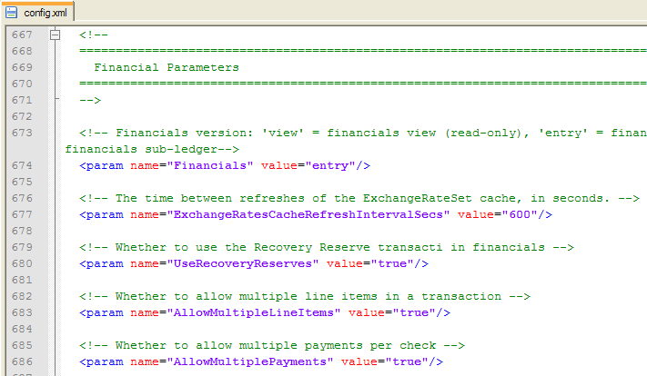
Financials and config.xml
Certain financial behaviors are controlled by parameters in config.xml
  Several are listed on the next slide, with defaults in black
Notes:
Introduction to transaction rules - <number>

Slide 13
Financial behaviors governed in config.xml
Multiple line items {are | are not} allowed in a transaction.
Multiple payments {are | are not} allowed per check.
Authority limits {are | are not} checked automatically
Users {cannot | can} submit payments that exceed available reserves {. | up to the PaymentsExceedReserves authority limit.}
Payments above {500} are logged.
When final payment is made, exposure {is | is not} automatically closed.
When final payment closed last open exposure, claim
{is | is not} automatically closed.
Notes:
Introduction to transaction rules - <number>
In each statement above, there is a "{ | }" set of characters. The text within the "{ |" (which appears in black) lists the out-of-box behavior of one of the financial parameters in config.xml. The text within the "| }" (which appears in gray) lists the non-default behavior of that financial parameter, but you can switch the parameter to this behavior simply by changing the parameter's value.
If payments can exceed authority limits but authority limits are not set for each role, you can make payments exceeding reserves without limit.
Some financial parameters in config.xml have been omitted from the list above. For the complete list, consult the config.xml file itself.

Slide 14
Lesson outline
Transaction basics
Transaction data model
Transactions and Gosu
The financial calculations library
Notes:
Introduction to transaction rules - <number>

Slide 15
Transaction sets and transactions
TransactionSet
Transaction
Amount
Subtype
...
Transactions
ReserveLine
Status
Subtype
TransactionAmount
...
Transaction data model is heavily subtyped
  At top level, transactionSet and transaction
Notes:
Introduction to transaction rules - <number>
There are three primary entities: transactionSet (which is subtyped as ReserveSet and CheckSet), transaction (which is subtyped as Reserve and Payment) and Check.
A transaction does not exist in isolation. Every transaction is part of a transaction set. In some cases, there may be only one transaction in the transaction set (such as a single reserve transaction creating a new reserve line, or a single check being issued with a single payment transaction from a single reserve line). In other cases, there may be multiple transactions in the transaction set (such as two reserve transactions creating two new reserve lines at one time, or three checks being issued, two of which have two payment transactions from different reserve lines).
The information stored at the transaction level is information generic to all transactions, such as which reserve line it is associated to, what its status is, and what the transaction amount is.
The information stored at the transactionSet level is information generic to all transaction sets, such as what the total amount is, and the array of transactions in the transaction set.

Slide 16
Entities for reserves
TransactionSet
Transaction
Amount
Subtype
...
Transactions
ReserveLine
Status
Subtype
TransactionAmount
...
ReserveSet
Reserve
Reserves
...
Notes:
Introduction to transaction rules - <number>
When a reserve is created, the transactionSet objects is subtyped as a ReserveSet and the transaction object is subtyped as a Reserve.
The Reserve subtype tracks information unique to reserve transactions. In the base application, there is a small number of fields at this level which are complex in nature (such as TotalIncurredGross, which is the total incurred gross for the given reserve).
The ReserveSet subtype tracks information unique to transaction sets which contain only reserves. In the base application, there is a single array key in this subtype, the Reserves field which contains an array of Reserve objects.

Slide 17
Entities for payments
TransactionSet
Transaction
Amount
Subtype
...
Transactions
ReserveLine
Status
Subtype
TransactionAmount
...
CheckSet
Check
Payment
PaymentsAmount
Recurring
...
Checks
CheckNumber
IssueDate
PaymentMethod
...
Payments
Check
CloseExposure
PaymentType
...
Notes:
Introduction to transaction rules - <number>
When a check is created, the transactionSet objects is subtyped as a CheckSet, the transaction object is subtyped as a Payment, and a third entity - the Check entity - becomes relevant.
The Payment subtype tracks information unique to payment transactions. In the base application, this includes a foreign key to the Check object which the payment belongs to, the CloseExposure boolean, which indicates whether the payment should or did close the associated exposure, and the payment type (partial, final, or supplemental).
The CheckSet subtype tracks information unique to transaction sets which contain checks. In the base application, this includes a PaymentsAmount which totals all the checks, a Recurring boolean indicating the check is single or recurring, and an array of Checks.
The Check entity includes information specific to the process of transferring money from the carrier to the payee. This includes the check number, the issue date, the payment method (check, EFT, or manual check), and an array of payment transactions which are contained within the check.
Eroding and Non-Eroding Payments in the data model
If a payment is "non-eroding", then the payment does not cause the amount of money in the reserve line to decrease. In this case, the only transactions that are created are payments. Carries use non-eroding payments when they want to use reserves as an estimate of money needed, but they do not track payments and remaining reserves at a granular level.
If a payment is "eroding", then the payment causes the amount of money in the reserve line to decrease. This means that each payment transaction requires a matching reserve transaction. (If the payment transaction is for $1000, then a reserve transaction must be created with an amount of -$1000 to reflect a $1000 decrease in the reserve line.) The payments are linked to the CheckSet through the Check entity as shown in the diagram above. The reserves are linked to the CheckSet through an array in the CheckSet subtype called Reserves. This is an array of CheckSetReserves. A CheckSetReserve is an object which links an automatically generated reserve transaction to a CheckSet.
(continued)

Slide 18
(Notes only slide)
Notes:
Introduction to transaction rules - <number>
To summarize this:
A transactionSet of type ReserveSet maps only to reserve transactions.
A transactionSet of type CheckSet maps only to payment transactions when none of the payments are eroding.
A transactionSet of type CheckSet maps to payment transactions and (automatically generated) reserve transactions when any of the payments are eroding.
The CheckSet subtype's Reserves array has been omitted from the diagram because, from a scripting standpoint, one rarely has to check the information in this array of CheckSetReserves. In almost all cases, the required information is in or connect to the Checks array.

Slide 19
Transaction data model: Review
TransactionSet
Transaction
Amount
Subtype
...
Transactions
ReserveLine
Status
Subtype
TransactionAmount
...
ReserveSet
Reserve
Reserves
...
CheckSet
Check
Payment
PaymentsAmount
Recurring
...
Checks
CheckNumber
IssueDate
PaymentMethod
...
Payments
Check
CloseExposure
PaymentType
...
Notes:
Introduction to transaction rules - <number>

Slide 20
Beyond the transaction data model
Claim
ReserveLine
Exposures
Claim
Exposure
Exposure
Claim
ReserveLines
Check
Claim
TransactionSet
Transaction
Claim
Exposures
LineItems
Claim
Exposure
ReserveLine
Two-way reference
One-way reference
Notes:
Introduction to transaction rules - <number>
The transactionSet, transaction, and Check entities are connected to other major entities in the ClaimCenter data model (Claim, Exposure, and ReserveLine). However, all of the references from the "transaction-type" entities are one-way. In other words, from a transactionSet, transaction, or Check, you can often navigate to the related Claim, Exposure, or ReserveLine. But, you cannot navigate easily from a Claim, Exposure, or ReserveLine to all of its transactionSets, transactions, or Checks. For rules, it is much better to use one of the getXXXIterator() methods to retrieve all transactions related to an object. (For the user interface, it is much better to use one of the getXXXQuery() methods to retrieve all transactions or a specific subtype of transactions.)
TransactionSet has an array key to Exposure, not a single foreign key. This is because a single transaction set could contain a check with payments from reserve lines associated to different exposures. For example, if a claim had a collision exposure and a bodily injury exposure with the same claimant, and a single check was issued to that claimant, then the check would involve payments from the reserve lines of two different exposures, but it would be in a single transaction set.
The transactionSet entity has a number of arrays which link to objects with information relevant to financial processing. For example:
The Exposures array points to a set of exposures. Each exposure has a foreign key to the associated coverage. Each coverage has an ExposureLimit field, identifying the maximum amount of loss covered on the policy.
The LineItems array points to a set of line items. Each line item has a line category, which is typically used by the check processing system to identify what the line item is for.

Slide 21
Lesson outline
Transaction basics
Transaction data model
Transactions and Gosu
The financial calculations library
Notes:
Introduction to transaction rules - <number>

Slide 22
Transactions and Gosu
TransactionSet and transaction are subtyped entities, and most critical information is at the subtype level
  Therefore, transaction rules typically involve casting
Reserves, payments, and checks are stored in arrays
  Therefore, transaction rules typically involve for loops
Transaction rules often use specific numeric amounts, but these amounts may change over time
  Therefore, transaction rules often involve script parameters
Notes:
Introduction to transaction rules - <number>

Slide 23
Review: Casting
Contact
if ((Contact as Person).CellPhone is null)
{
...
...
}
ID
Subtype
CellPhone
Person
Casting is a technique used with supertype objects to reference fields and methods that exist only at the subtype level
Syntax:
(objectLevel as subtypeLevel)
Notes:
Introduction to transaction rules - <number>
Working with subtyped entities can be difficult, because sometimes you have an object declared at the supertype level but you need to access fields and methods found only at the subtype level. "Casting" is a coding technique where you create a second handle for an object at the supertype level which lets you access subtype fields.

Slide 24
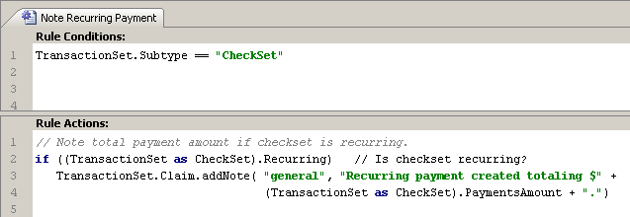
Example of transaction rule casting
Notes:
Introduction to transaction rules - <number>
In the example above, the rule creates a note whenever a recurring payment is issued which identifies the total amount of all payments.
In the rule condition, line 1 checks to see if the transactionSet is a CheckSet. If it isn't, then there is no need to execute further processing.
In the rule action:
Line 2 needs to access the Recurring attribute. This attribute exists only at the CheckSet subtype level. Therefore, the transactionSet object is cast as a CheckSet object.
Line 3 creates a note for the transactionSet's claim. The Claim foreign key exists at the transactionSet level. Therefore, the transactionSet object does not need to be cast in this case.
Line 4 adds the PaymentsAmount value to the note text. Once again, this attribute exists only at the CheckSet subtype level. Therefore, the transactionSet object is cast as a CheckSet object.

Slide 25
Review: for loops
Exposure
for (exp in aClaim.Exposures)
{
if exp.Segment == "complex"
aClaim.Segment = "complex"
}
Claim
Exposure
Exposures
Exposure
In Gosu, for loops are typically used to perform a set of actions over every element in an array
For Loop syntax:
  for ( loopIdentifier in arrayOrSet)
  {
  block_that_makes_use_of_loopIdentifier
  }
Notes:
Introduction to transaction rules - <number>
For loops are not, by definition, a feature exclusive to arrays. However, the vast majority of ClaimCenter code that uses for loops uses them in conjunction with arrays. This is because a for loop is designed to execute the same steps multiple times, and the processing of an array usually involves several items and the notion that you want to do the same thing to each item.
The arrayOrSet in the in clause must evaluate to one of the following:
An array
A Java List (or any Java collection)
A Java Iterator
A string (as a list of characters)

Slide 26
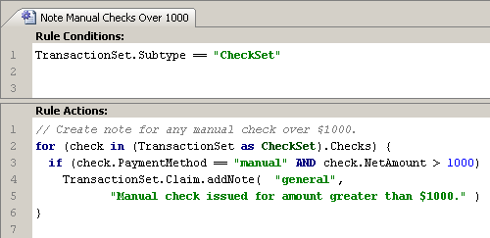
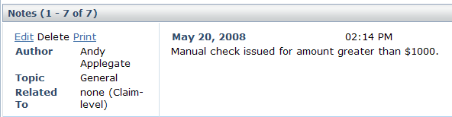
Example of transaction rule for loops
Notes:
Introduction to transaction rules - <number>
In the example above, the rule creates a note whenever a manual check is issued for an amount over $1000.
In the rule condition, line 1 checks to see if the transactionSet is a CheckSet. If it isn't, then there is no need to execute further processing.
A check set contains array of checks. There may be only one check, but there could be several. Consequently, in the rule action, the code that interacts with individual checks must make use of a loop.
Line 2 creates the for loop. "check" is arbitrary name used to reference the check currently being processed. The for statement also specifies the array which the loop processes. Because the Checks array exists only at the CheckSet subtype level, the transactionSet must be cast as a CheckSet.
Line 3 checks if the payment method for the current check is "manual" and if the net amount for the current check is greater than $1000. If it is true, then one lines 4 and 5 and note is created.
Strictly speaking, the curly braces in lines 2 and 6 are not needed. Curly braces are needed only if the for loop contains multiple statements. (This loop contains a single if statement with an embedded addNote statement.) However, in most cases, multiple lines are executed within the loop. Some programmers consider it good practice to always include the braces, even if the loop has only one line, to avoid compile errors if additional lines are added.

Slide 27
Review: Script parameters
SIU_Threshold
5
if aClaim.SIScore >= ScriptParameters.SIU_Threshold
aClaim.createActivityFromPattern(null,
ActivityPattern(ActivityPattern.finder.
getActivityPatternByCode("SI_review"))
Script parameters are used to reference "hard-coded" values which could change over time
Syntax:
  ScriptParameters.parameterName
Notes:
Introduction to transaction rules - <number>
Script parameters are not unique to arrays and loops. They can be used anywhere a relatively static or slowly changing value is required.

Slide 28
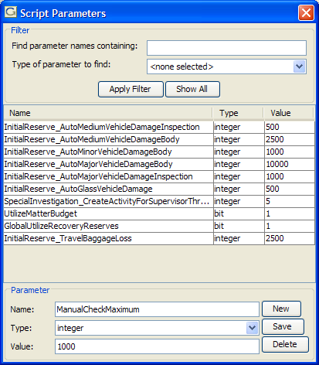
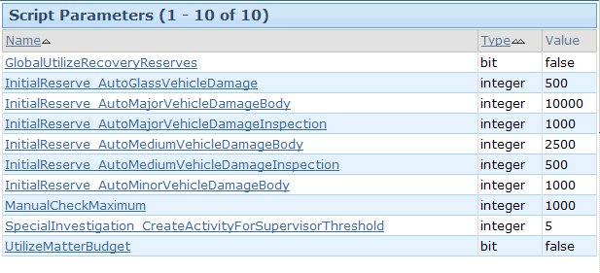
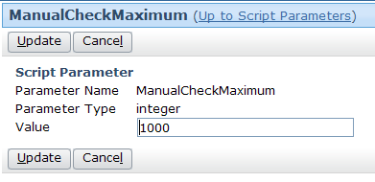
Example of transaction script parameters
Notes:
Introduction to transaction rules - <number>
In the example above, a script parameter called ManualCheckMaximum is created as an integer with an initial value of 1000. Once it has been deployed, administrators can modify the value from the Administration tab's Script Parameters screen as shown on the right.

Slide 29
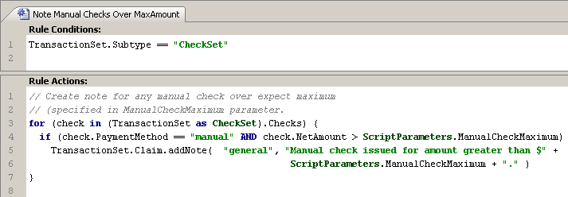
Example of transaction script parameters in rules
Notes:
Introduction to transaction rules - <number>
The example above is identical to the loop example, except that the hard-coded value of 1000 has been parameterized.
Lines 4 and 6 reference the parameter using "ScriptParameters.ManualCheckMaximum". Now, the rule will react to whatever value is specified in ClaimCenter's Script Parameters screen (on the Administration tab), both in terms of the condition and the note text.

Slide 30
Transaction data model and Gosu
Root
Entity
for loops
TransactionSet
Transaction
Amount
Subtype
...
Transactions
ReserveLine
Status
Subtype
TransactionAmount
...
for (txn in
Transactions)
ReserveSet
Reserve
casting
...
(TransactionSet as CheckSet)
(Transaction
as Payment)
Reserves
CheckSet
Check
Payment
PaymentsAmount
Recurring
...
Checks
CheckNumber
IssueDate
PaymentMethod
...
Payments
Check
CloseExposure
PaymentType
...
for (check
in Checks)
for (payment
in Payments)
Notes:
Introduction to transaction rules - <number>
The root entity for all transaction rules is transactionSet. Typically, the information you need is not in the transactionSet entity itself, but rather in ReserveSet, CheckSet, Check, transaction, Reserve, or Payment.
To move from an array to the objects contained in an array (in other words, to move across the diagram), you must use a for loop. For example, to examine all the checks in a checkset, code such as (check in Checks) would be needed.
To move from a supertype to one of its subtypes (in other words, to move down the diagram), you must use casting. For example, to examine all a CheckSet from the root entity transactionSet, code such as (TransactionSet as CheckSet) would be needed.
To move diagonally, you must loops and casting. For example, to examine all the Checks in a transactionSet, code such as for (check in (TransactionSet as CheckSet).Checks) would be needed.
The word "transaction" is often abbreviated in code as "txn".

Slide 31
Lesson outline
Transaction basics
Transaction data model
Transactions and Gosu
The financial calculations library
Notes:
Introduction to transaction rules - <number>

Slide 32
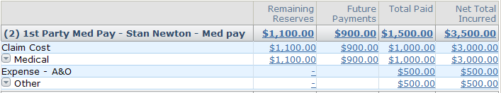
Measuring a claim's financials
Insurance carriers use a set of measures to describe and act on a claim, such as the base application measures:
  Open reserves =
  all approved reserves - past payments
  Remaining reserves =
  open reserves - future payments
  Available reserves =
  remaining reserves - pending approval payments
  Gross total incurred = open reserves + all past payments
  Net total incurred = gross total incurred - recoveries
Notes:
Introduction to transaction rules - <number>
The terms used to describe the finances for a claim are completely configurable. The definitions provided above are listed only to help identify the calculations already executed in the base application.
Available reserves does not appear on the summary screen in the base application, but it appears on screens in the payment wizard and it is used by business rules. Therefore, it is defined in the slide above.
A reserve can be either approved or pending approval. The approval status effects whether it is included in open and remaining reserves.
A payment can be either in the past (it has already taken place) or in the future (it is scheduled to take place, which could include single future payments or recurring payments). The status of a payment effects the calculation for in open reserves, remaining reserves, and available reserves.

Slide 33
(Notes only slide)
Notes:
Lesson Name- <number>
TotalReserves = Sum of all approved reserves (excludes only PendingApproval and earlier statuses)
TotalReservesWithPending = TotalReserves + PendingApprovalReserves
OpenReserves = TotalReserves - all eroding Payments made today or earlier
RemainingReserves = OpenReserves - all eroding Payments to be made after today [can be <0*]
AvailableReserves = RemainingReserves - PendingApprovalErodingPayments [can be <0*]
TotalPayments = Sum of all approved payments with scheduled send date today or earlier
FuturePayments = Sum of all approved payments with a scheduled send date after today
TotalPaymentsWithPending = TotalPayments + FuturePayments + PendingApprovalPayments
GrossTotalIncurred = OpenReserves + TotalPayments, or equivalently,
TotalReserves + Sum of all approved non-eroding payments
NetTotalIncurred = GrossTotalIncurred - TotalRecoveries
TotalIncurredNetRecoveries = GrossTotalIncurred - TotalRecoveries (the same as NetTotalIncurred)
TotalIncurredNetRecoveryReserves = GrossTotalIncurred - TotalRecoveryReserves
TotalRecoveryReserves = Sum of all recovery reserves (unlike reserves, they need no approval)
TotalRecoveries = Sum of all recoveries with submitted status (all recoveries received up to now)
OpenRecoveryReserves = TotalRecoveryReserves - TotalRecoveries
PendingApprovalErodingPayments = Sum of all eroding payments with pending approval status
PendingApprovalNonErodingPayments = Sum of all non-eroding payments with pending approval status
PendingApprovalPayments = PendingApprovalErodingPayments + PendingApprovalNonErodingPayments
PendingApprovalReserves = Sum of all reserves with pending approvalstatus
ForeignExchangeAdjustments = The sum of all exchange rate adjustments, both those made to eroding and to non-eroding payments.
ErodingPaymentsForeignExchange- Adjustments = The sum of all exchange rate adjustments made to eroding payments.
NonErodingPaymentsForeignExchange- Adjustments = The sum of all exchange rate adjustments made to non-eroding payments.

Slide 34
Transaction rules and financial measures
getTotalPayments()
getAmount(aClaim)
Financial
Calculation
$1500
Transaction rules need to reference financial measures
Accomplished through financial calculations library methods
  Each method returns a "cache reader" object which can be used to retrieve financial measures
Notes:
Introduction to transaction rules - <number>

Slide 35
Financial calculation library methods
Syntax:
gw.api.financials.FinancialsCalculationUtil.method
  Returns object of type FinancialCalculation
Commonly used methods
  getAvailableReserves()
  getOpenReserves()
  getRemainingReserves()
  getTotalNetIncurred
  getTotalReserves()
  getTotalPayments()
Notes:
Introduction to transaction rules - <number>
A list of all the methods appear below, and is further explained in the ClaimCenter rules Guide:
getAvailableReserves()
getOpenRecoveryReserves()
getOpenReserves()
getRemainingReserves()
getTotalIncurredGross()
getTotalIncurredNet()
getTotalIncurredNetMinusOpenRecoveryReserves()
getTotalPayments()
getTotalPaymentsIncludingPending()
getTotalRecoveries
getTotalReserves()
getTotalReservesIncludingPending()

Slide 36
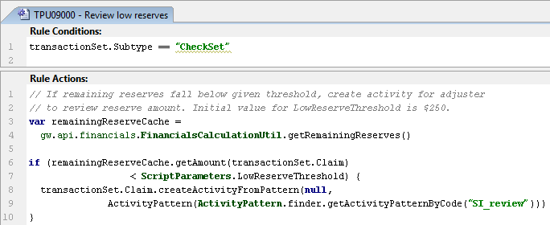
Methods on FinancialCalculation objects
getAmount - commonly used syntax:
  getAmount(Claim)
  getAmount(Exposure)
  getAmount(Exposure, CostType)
  getAmount(Claim, Exposure, CostType, CostCategory)
Notes:
Introduction to transaction rules - <number>
Note: In ClaimCenter7.0.0, the gw.api.financials.FinancialsCalculationUtil.getRemainingReserves() function has been erroneously marked as deprecated. This has been fixed in ClaimCenter 7.0.1.
The getAmount() method contains multiple overloaded versions. All return a monetary value for the calculation on which they are called, limited by the passed-in parameters. The following examples illustrate these methods. Note that all examples assume a code prefix of gw.api.financials.FinancialsCalculationUtil.
getTotalReserves().getAmount(claim) - Returns the Total Reserves amount for the passed-in Claim.
getTotalReserves().getAmount(exposure) - Returns the Total Reserves amount only for the passed-in Exposure. For example, it returns only those reserve transactions coded to this exposure.
getOpenReserves().getAmount(exposure, CostType) - Returns the amount of Open Reserves only for the passed-in Exposure and CostType values. It returns only those reserves and payments coded to this exposure and cost type, regardless of cost category coding.
getAmount(claim: Claim, exposure: Exposure, costType: CostType, costCategory: CostCategory) - Accepts null values for everything except Claim, and it matches those values explicitly. So, if this method is called with a null value for “exposure”, it only matches claim-level transactions.
In the example above, the rule creates an activity when the remaining reserves fall below a threshold amount (which is specified through a script parameter).
In the rule condition, line 1 checks to see if the transactionSet is a CheckSet. If it isn't, then there is no need to execute further processing.
In the rule actions, lines 4 and 5 create a cache reader object which can be used to get remaining reserve amounts.
Line 6 gets the remaining reserves for the transactionSet's claim.
Line 7 checks to see if that amount is below the threshold amount ($250). If so…
Lines 8 and 9 create an activity to have an adjuster review the low reserve amount.

Slide 37
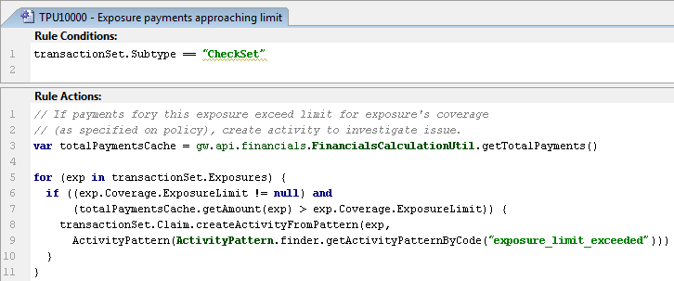
Using financial calculations library: Examples
Line 3 creates cache reader object
For each exposure, line 7 retrieves total payments for that exposure and compares it to exposure's limit
Notes:
Introduction to transaction rules - <number>
In the example above, the rule creates an activity when the payments for an exposure exceed the limit of the coverage as specified by the policy.
In the rule condition, line 1 checks to see if the transactionSet is a CheckSet. If it isn't, then there is no need to execute further processing.
In the rule actions, line 3 creates a cache reader object which can be used to get total payment amounts.
Line 5 initiates a for loop to process each exposure.
Lines 6 and 7 check to see if the current exposure's limit is non-null and if the total payment amount is above the exposure limit. If it is...
Lines 8 and 9 create an activity to have an adjuster review what to do about the exceeded limit.

Slide 38
Lesson objectives review
You should now be able to:
  Describe the different sets of transaction rules
  Describe the transaction data model
  Use the Financial Calculations library
  Work with transactions in Gosu
Notes:
Introduction to transaction rules - <number>

Slide 39
Review questions
What are the two primary subtypes of transactionSet?
What are the two primary subtypes of transaction?
Which primary entity in the transaction data model is neither a subtype of transactionSet or transaction? Under what circumstances is this entity relevant?
Why do transaction rules frequently make use of:
  Casting?
  Loops?
  Script parameters?
When would one use the methods in the Financial Calculations library?
Notes:
Introduction to transaction rules - <number>
Answers
1. ReserveSet and CheckSet
2. Reserve and Payment (not Check...Check is not a subtype of transaction)
3. Check. When payments are made.
4. a) The transactionSet and transaction entities are subtyped, and casting is needed to access fields and methods at the subtype level.
b) Checks, reserves, and payments are all stored in arrays. For loops are needed to process these arrays.
c) transaction rules often reference specific values, but these values may change over time and should not require changes to the code. Script parameters lets you change these values without changing the code.
5. These methods are used when one needs to use a common financial measurement (such as open reserves or total payments) in a transaction rule.

Slide 40
Notices
Copyright © 2001-2011 Guidewire Software, Inc. All Rights Reserved.
Guidewire, Guidewire Software, Guidewire ClaimCenter, Guidewire PolicyCenter, Guidewire BillingCenter, Guidewire Reinsurance Management, Guidewire ContactManager, Guidewire Vendor data Management, Guidewire Client data Management, Guidewire InsuranceSuite, Guidewire ContactCenter, Guidewire Studio, Gosu, Deliver Insurance Your Way, and the Guidewire logo are trademarks or registered trademarks of Guidewire Software, Inc. in the United States and/or other countries.
This material is Guidewire proprietary and confidential. The contents of this material, including product architecture details and APIs, are considered confidential and are fully protected by customer licensing confidentiality agreements and signed Non-Disclosure Agreements (NDAs).
This file and the contents herein are the property of Guidewire Software, Inc. Use of this course material is restricted to students officially registered in this specific Guidewire-instructed course, or for other use expressly authorized by Guidewire. Replication or distribution of this course material in electronic, paper, or other format is prohibited without express permission from Guidewire.
    Guidewire products are protected by one or more of the following patents: U.S. Patent No. 7,885,831; U.S. Patent No. 7,788,296.
Notes:
Introduction to Guidewire Configuration - <number>

